Slide 1


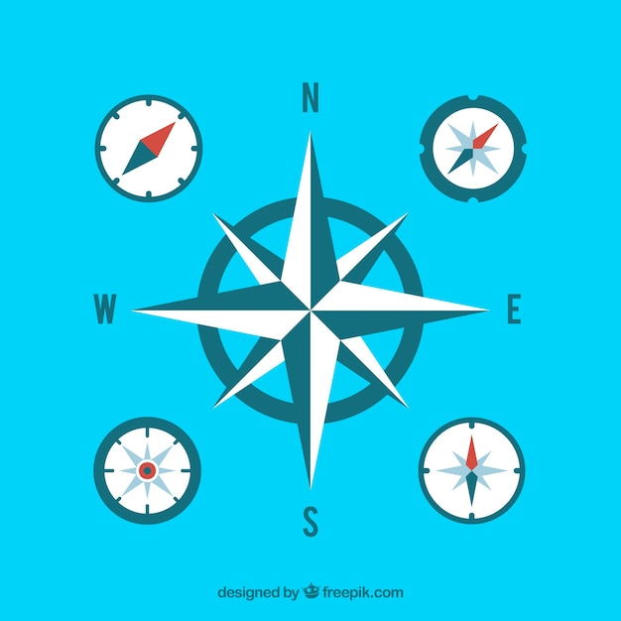
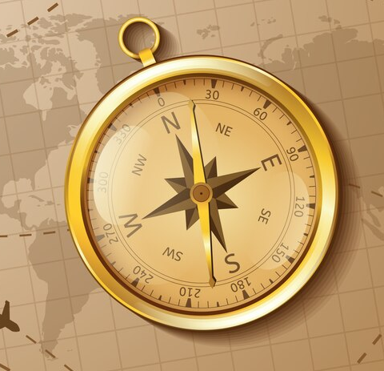
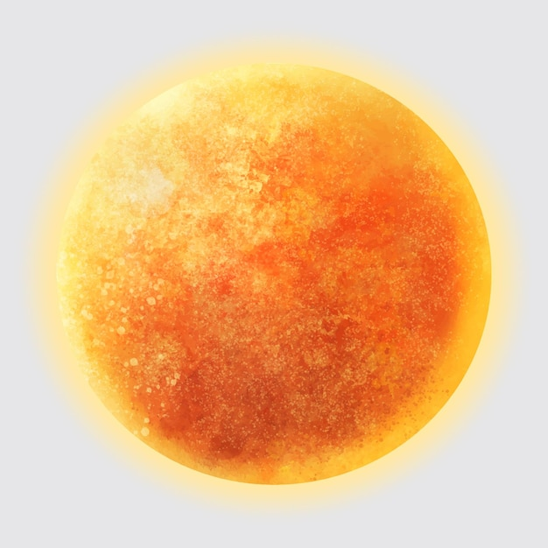

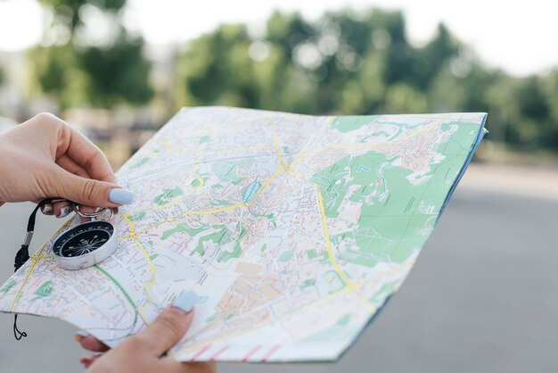
ORIENTATION
GPS and MAPS are guidance tools and are used to guide us when we move around in space.
We can also guide ourselves with the help of STARS and PLANETS.
(freepik)

Slide 2
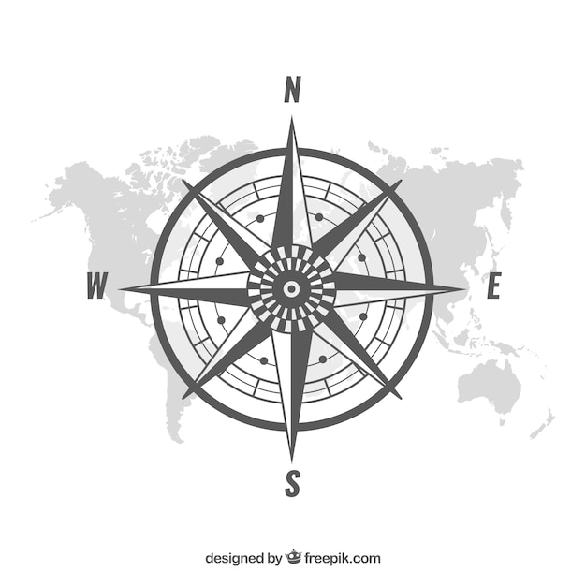
ORIENTATION
The directions north, south and west are the cardinal points that allow us to identify our location anywhere on earth.
O/

Slide 3
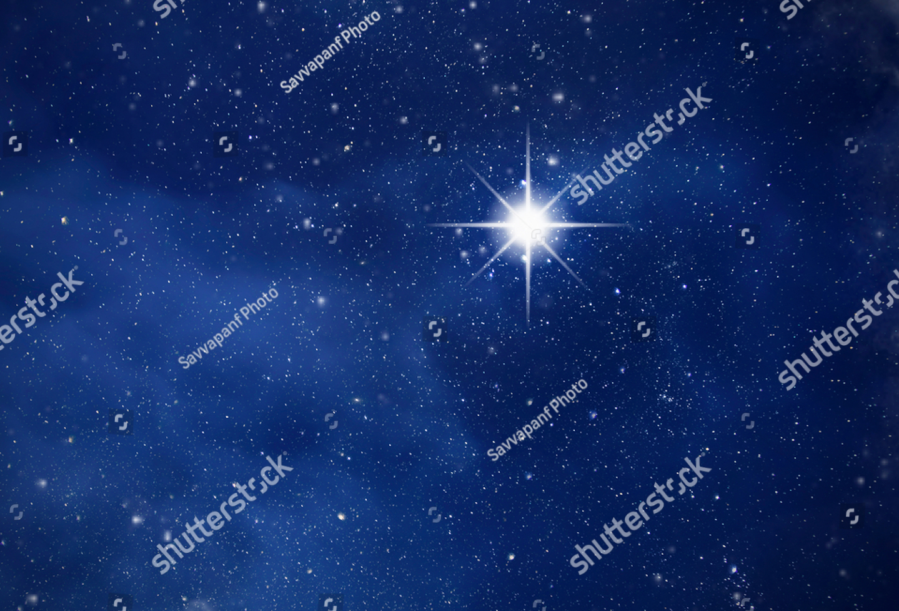
GUIDANCE
In the northern hemisphere, the constant position of the earth's axis allows us to locate the NORTHERN CARDINAL POINT.

Slide 4
ORIENTATION
By observing the position of the SUN in the sky, we can guide ourselves.
Its diurnal movement serves as a form of orientation, as the sun indicates different directions throughout the day.
The sun rises in the east (E) and sets in the west (W).
Freepik

Slide 5






2022-1-BG01-KA220-SCH-000085065
Subject: Natural Science
Age of students: 9 – 10 years old
Topic: Nature
Resource Title: Orientation: the basics to find your way
Credits: AECE – Escola Básica da Zona Verde
All media are within the EU intellectual property law.
The European Commission’s support for this publication does not constitute an endorsement of the contents, which reflect the views only of the authors, and the Commission cannot be held responsible for any use which may be made of the information contained herein.

